Slide 1


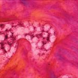

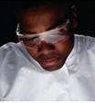

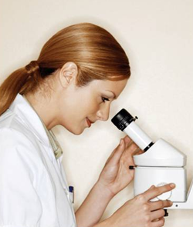
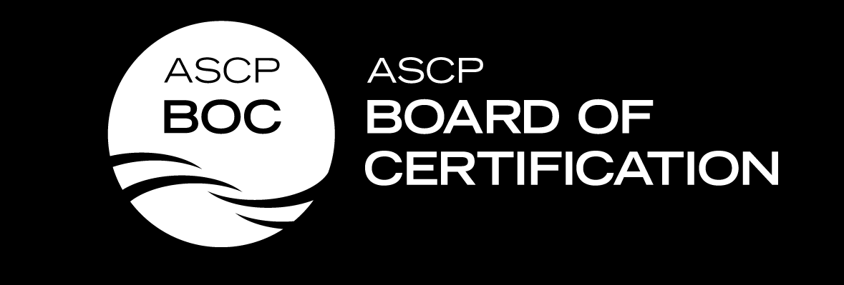
ASCP Board of Certification Update
October 2017
Kathleen Hansen, MLS(ASCP)^{CM}
Past Chair, Board of Governors

Slide 2
NAACLS Accredited Programs Nationally
Program | 2008 | 2009 | 2010 | 2011 | 2012 | 2013 | 2014 | 2015 | 2016
MLS | 222 | 230 | 228 | 226 | 227 | 229 | 223 | 229 | 222
MLT | 205 | 216 | 216 | 223 | 231 | 237 | 241 | 250 | 249
HT/HTL | 33 | 37 | 35 | 44 | 46 | 46 | 45 | 45 | 44
PBT | 60 | 62 | 62 | 68 | 71 | 72 | 68 | 66 | 63

Slide 3
NAACLS Accredited Minnesota Programs
MLS
  Argosy (Eagan)
  HCMC
  Mayo
  St. Cloud
  U of M
  Winona State
  (3% of programs nationally)
MLT
  Alexandria
  Hibbing
  Lake Superior
  MN State SE (Winona)
  Fergus Falls
  MN West (Luverne)
  North Hennepin
  St. Paul College
  S. Central (Mankato)
  Argosy (Eagan)
  Rasmussen (Lake Elmo, Moorhead, St. Cloud)
  (5% of programs nationally)

Slide 4
NAACLS Accredited Minnesota Programs
HT
  Argosy
  Mayo
  North Hennepin
  (7% of programs nationally)
HTL
  none
PBT
  HCMC
  Mayo
  St. Catherine’s
  (5% of programs nationally)

Slide 5
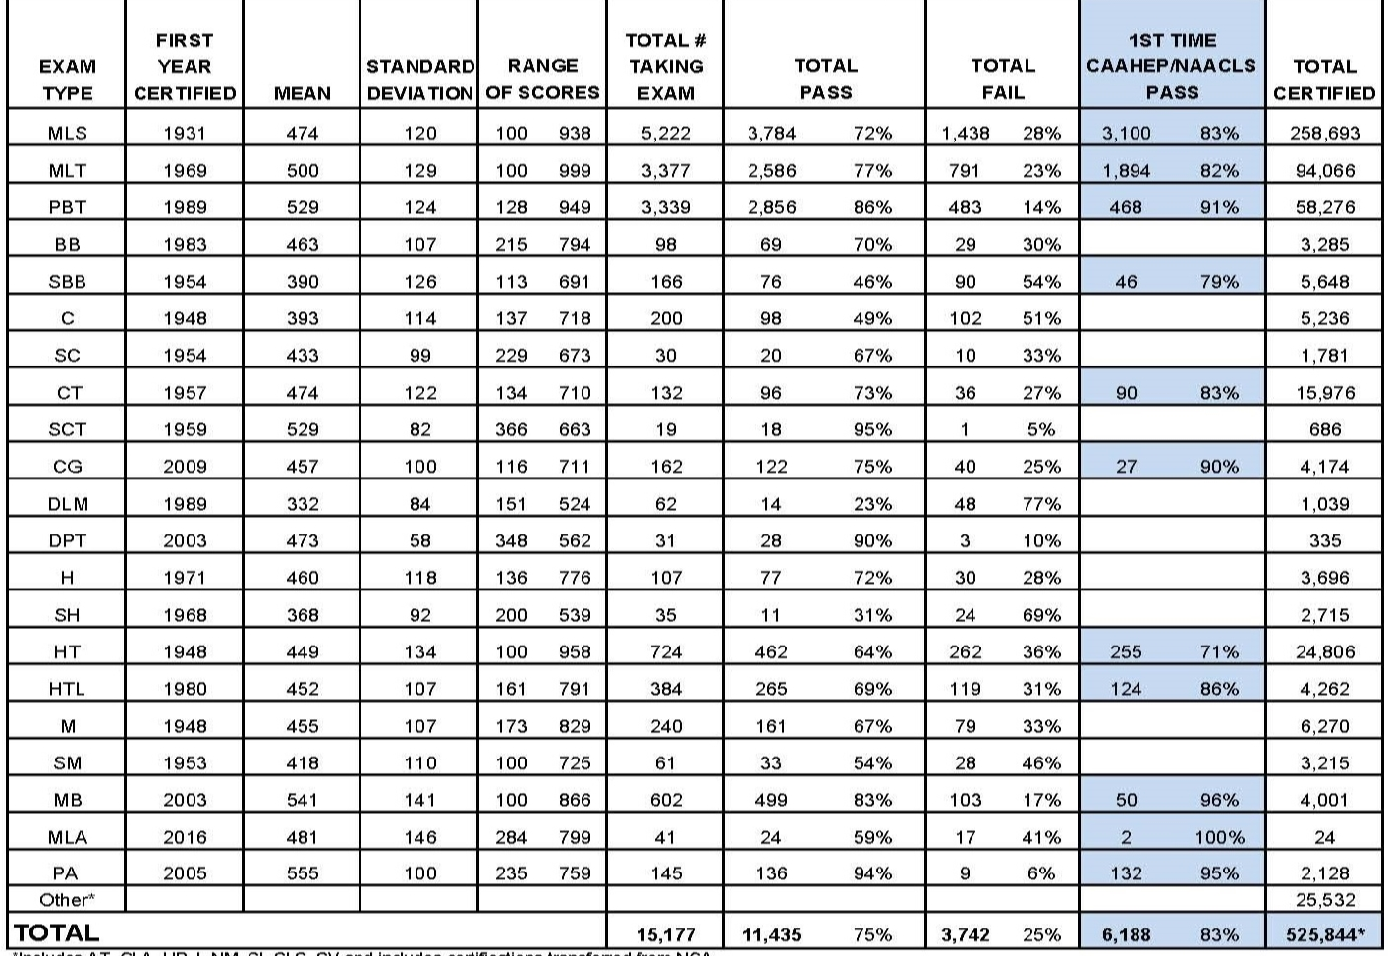
Examination Statistics 2016
Notes:
Available on the website
Point out MLA stats – began 7/1/17, 2 - 1st time NAACLS, 100% pass rate

Slide 6
Graduates of NAACLS Accredited Programs 2015-2016
2015-2016 In 2016-2017
MLS 3932 3037 took exam
MLT 2856 2290 took exam
HT 467 236 took exam
HTL 77 106 took exam
PBT 1808 497 took exam

Slide 7
Examination Statistics July 2016-June 2017
Exam Type | Total # Taking Exam | Total Pass | Total % Pass | Total Fail | Total % Fail | NAACLS program grad Pass | NAACLS % Pass
MLS | 5161 | 3775 | 73% | 1406 | 27% | 3037 | 83%
MLT | 3334 | 2541 | 76% | 793 | 24% | 2290 | 82%
PBT | 3450 | 3008 | 87% | 442 | 13% | 497 | 93%
HT | 705 | 444 | 63% | 261 | 37% | 236 | 73%
HTL | 374 | 254 | 68% | 120 | 32% | 106 | 88%

Slide 8
Examinees 2016

Slide 9
Certificants 2016

Slide 10
MLS Examination Statistics
 | 2012 | 2013 | 2014 | 2015 | 2016
Total Examinees | 4298 | 4473 | 4635 | 4918 | 5222
Mean | 485 | 485 | 486 | 469 | 474
Pass | 3370 | 3504 | 3613 | 3533 | 3784
Pass % | 78% | 78% | 78% | 72% | 72%
NAACLS 1st Time Pass # | 2864 | 2953 | 3043 | 2975 | 3100
NAACLS 1st Time Pass % | 86% | 86% | 86% | 81% | 83%

Slide 11
MLT Examination Statistics
 | 2012 | 2013 | 2014 | 2015 | 2016
Total Examinees | 3244 | 3422 | 3861 | 3445 | 3377
Mean | 483 | 485 | 485 | 499 | 500
Pass | 2385 | 2537 | 2833 | 2656 | 2586
Pass % | 74% | 74% | 73% | 77% | 77%
NAACLS 1st Time Pass | 1855 | 1921 | 2070 | 1962 | 1894
NAACLS 1st Time Pass % | 81% | 80% | 80% | 83% | 82%

Slide 12
HT Examination Statistics
 | 2012 | 2013 | 2014 | 2015 | 2016
Total Examinees | 781 | 783 | 723 | 676 | 724
Mean | 456 | 455 | 449 | 449 | 449
Pass # | 521 | 523 | 462 | 422 | 462
Pass % | 67% | 67% | 64% | 62% | 64%
NAACLS 1st Time Pass # | 326 | 315 | 286 | 248 | 255
NAACLS 1st Time Pass % | 72% | 76% | 72% | 73% | 71%

Slide 13
HTL Examination Statistics
 | 2012 | 2013 | 2014 | 2015 | 2016
Total Examinees | 336 | 324 | 370 | 328 | 384
Mean | 431 | 421 | 427 | 457 | 452
Pass | 209 | 189 | 227 | 231 | 265
Pass % | 62% | 58% | 61% | 70% | 69%
NAACLS 1st Time Pass # | 76 | 60 | 90 | 91 | 124
NAACLS 1st Time Pass % | 74% | 67% | 78% | 83% | 86%

Slide 14
PBT Examination Statistics
 | 2012 | 2013 | 2014 | 2015 | 2016
Total Examinees | 3486 | 3419 | 3378 | 3121 | 3339
Mean | 518 | 518 | 520 | 531 | 529
Pass # | 2942 | 2887 | 2880 | 2695 | 2856
Pass % | 84% | 84% | 85% | 86% | 86%
NAACLS 1st Time Pass # | 467 | 489 | 503 | 446 | 468
NAACLS 1st Time Pass % | 88% | 87% | 88% | 90% | 91%

Slide 15
MLA Certification Available
The Medical Laboratory Assistants, MLA (ASCP) certification is now available.
Graduates of NAACLS approved Clinical Assistant programs are eligible to apply for this certification. Experience based eligibility routes also exist.
Please see the MLA eligibility requirements (available on the BOC website)
The application fee is $135.

Slide 16
Questions?
khansen3@fairview.org

