Slide 1

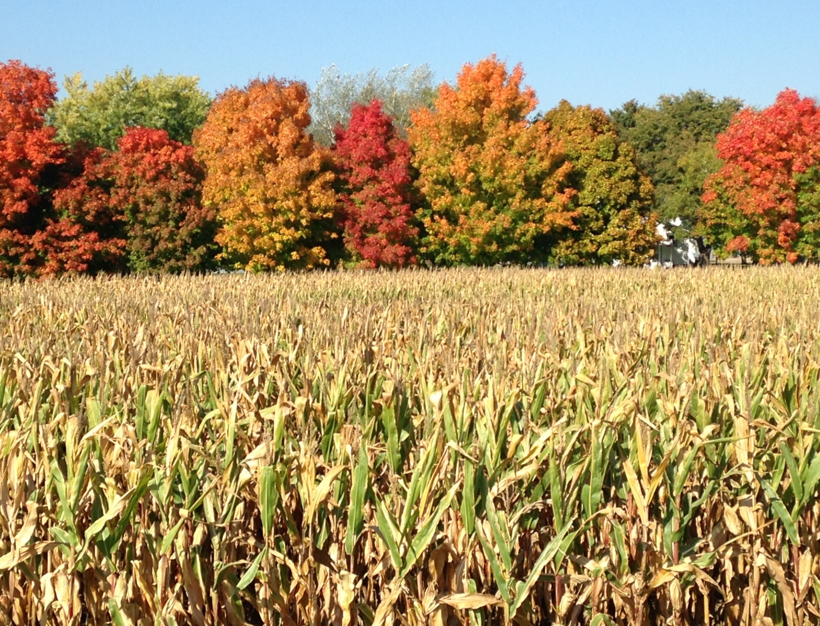
The Minnesota Rural Health Association
The Voice of Rural Health!

Slide 2
The Minnesota Rural Health Association
M I S S I O N
MRHA is a non-profit, membership organization missioned to strengthen the health, health care and well-being of rural Minnesotans through leadership, advocacy, education and collaboration.
V I S I O N
MRHA is the leading coordinating and advocacy organization for strengthening health and health care for rural Minnesotans.

Slide 3

The Minnesota Rural Health Association
As rural communities in Minnesota pursue the triple aim of greater access to higher quality, more cost effective health care, along with improved health and wellness, they face many unique challenges compared to metro-area residents.

Slide 4
The Minnesota Rural Health Association
Unique Challenges In Our Rural Communities
An increasingly older and lower income population which relies more heavily on public health care programs that pay below cost
An older and dramatically shrinking health care workforce (primary and specialty care) with fewer new providers to replace them
Hospitals, clinics, nursing homes and other providers under increasing financial stress - many having to close their doors

Slide 5
The Minnesota Rural Health Association
Unique Challenges In Our Rural Communities
Limited access to dental, mental health, obstetrics and other specialty care
New health care requirements (EHR, Meaningful Use, value-based payment, quality measures, and more) but with
fewer resources to achieve them
The need for access to a skilled healthcare workforce and data analytics

Slide 6

The Minnesota Rural Health Association
Top Issues Impacting Rural Health
  Healthcare Workforce Shortage
  Access Challenges
  Transportation
  Broadband Shortage
  Reimbursement Disparities
  Hospitals, Clinics, Nursing Homes In Crisis

Slide 7
The Minnesota Rural Health Association
Healthcare Workforce Shortage
The MN Medical Association (MMA), MN Hospital Association (MHA) and Minnesota Department of Health (MDH) all predict a physician shortage of between 800 to a few thousand in both primary and specialty care in the next several years
Fewer medical students are choosing primary care
Lack of funding, facilities, faculty and the federal cap on residency slots are barriers to producing more rural health care providers
Recruiting challenges, including cost of recruiting, pay disparities, call rotations, spousal employment and others

Slide 8
The Minnesota Rural Health Association
Healthcare Workforce Shortage
Population per physician in Minnesota:
        Twin Cities metro – 297
        Small town/Small rural – 674
        Rural/Isolated – 2,043
        Source: Minnesota Department of Health, Office of Rural Health and Primary Care

Slide 9
The Minnesota Rural Health Association
Access Challenges
In addition to a growing shortage of primary care, the Minnesota Department of Health, Office of Rural Health and Primary Care, has identified lack of access to certain specialty care, including
  Obstetrics
  Mental health
  Dental care
  Language interpreters
  Pharmacy / medication therapy management

Slide 10
The Minnesota Rural Health Association
Transportation
Rural Minnesotans list access to transportation as their top concern, especially among seniors who often require door-to-door rides that public services cannot accommodate.
Volunteers are filling gaps in some rural communities while many more rural residents are simply too far from the transportation they need to remain healthy in-place.

Slide 11
The Minnesota Rural Health Association
Broadband Shortage
Telemedicine, tele-mental health, tele-education, tele-monitoring, telephone apps and robotic assistance are all vital to extending quality, cost-effective care to rural communities
Major portions of rural Minnesota lack the broadband access necessary for tele-health and tele-medicine applications

Slide 12
The Minnesota Rural Health Association
Reimbursement Disparities
Rural health care providers serve a disproportionately large number of residents who rely on public health care programs
Public programs (Medicare, Medicaid and others) often pay below cost and are increasingly reducing reimbursement
Despite a high percentage of Minnesotans with health insurance, many still face unaffordable deductibles and other barriers to covering health care costs

Slide 13
The Minnesota Rural Health Association
Hospitals, Clinics, Nursing Homes In Crisis
Most hospitals in rural Minnesota operate in the red or with margins of less than 5 percent, making new health care reform requirements more difficult to afford.
The health care infrastructure in much of rural Minnesota is a web of small hospitals, clinics and nursing homes, often attached to the hospitals and often experiencing significant financial stress.
Many rural hospitals have financial margins too narrow or too low to support investments in critical plant and technological upgrades.

Slide 14
The Minnesota Rural Health Association
Hospitals, Clinics, Nursing Homes In Crisis
Medicaid and Medicare reimbursement rates remain generally below actual costs of services provided, stressing rural providers that depend more heavily on reimbursements from public programs.
Many rural long-term care facilities are at risk of closure, affecting the health care safety net for the rural elderly.

Slide 15
The Minnesota Rural Health Association
Achieving and Maintaining Health and Wellness
According to a study by the University of Wisconsin and the Robert Wood Johnson Foundation which ranked the overall health of Minnesotans by county, the worst health problems were found in rural parts of our state. Poor health outcomes were particularly concentrated in north central and northeastern Minnesota.

Slide 16
The Minnesota Rural Health Association
Why join The Minnesota Rural Health Association?
Leadership – Join “The Voice of Minnesota Rural Health,” a statewide, grassroots coalition working for positive change.
Education – Opportunities and resources to stay on top of issues impacting Minnesota rural health and healthcare
Advocacy – Collectively informing and urging policymakers and others to meaningfully address rural health challenges
Collaboration – Together accomplishing more than we can apart!

Slide 17
The Minnesota Rural Health Association
Alone we can do so little;
together we can do so much.
- Helen Keller
The secret is to gang up on the problem, rather than each other.
-Thomas Stallkamp

Slide 18

The Minnesota Rural Health Association
Thank you.
Minnesota Rural Health Association
Steve Gottwalt, Executive Director
    P.O. Box 421
    Waite Park, MN 56387
    (952) 923-5265
    steve@mnruralhealth.org
    www.MNRuralHealth.org

Slide 19
The Minnesota Rural Health Association
www.MNRuralHealth.org

