Slide 1

Minnesota’s Healthcare Workforce Data
Healthcare Education and Industry Partnership
September 10, 2015
Teri Fritsma, Senior Workforce Analyst, MDH

Slide 2
Today’s discussion
Overview of the healthcare workforce data available in Minnesota
Walk through an example of how these data can be applied to a policy question
Update on NGA data work

Slide 3
What exactly is “healthcare workforce data?”
Wages
Demographics—especially race and age
Career laddering/trajectories
Educational program completers
Rural/urban differences
Job vacancy rates
Projected workforce needs

Slide 4

How do YOU (or how would you)
use workforce data?

Slide 5
Today’s discussion
Overview of the healthcare workforce data available in Minnesota
Walk through an example of how these data can be applied to a policy question
Update on NGA data work

Slide 6
Overview of available healthcare workforce data
WHO?
MN Department of Health
MN Hospital Association
Care Providers of Minnesota
MN DEED
MN Department of Education
MN Office of Higher Education
MN Health licensing boards
IPEDS (federal)
“Help Wanted Online” (Private data source)

Slide 7
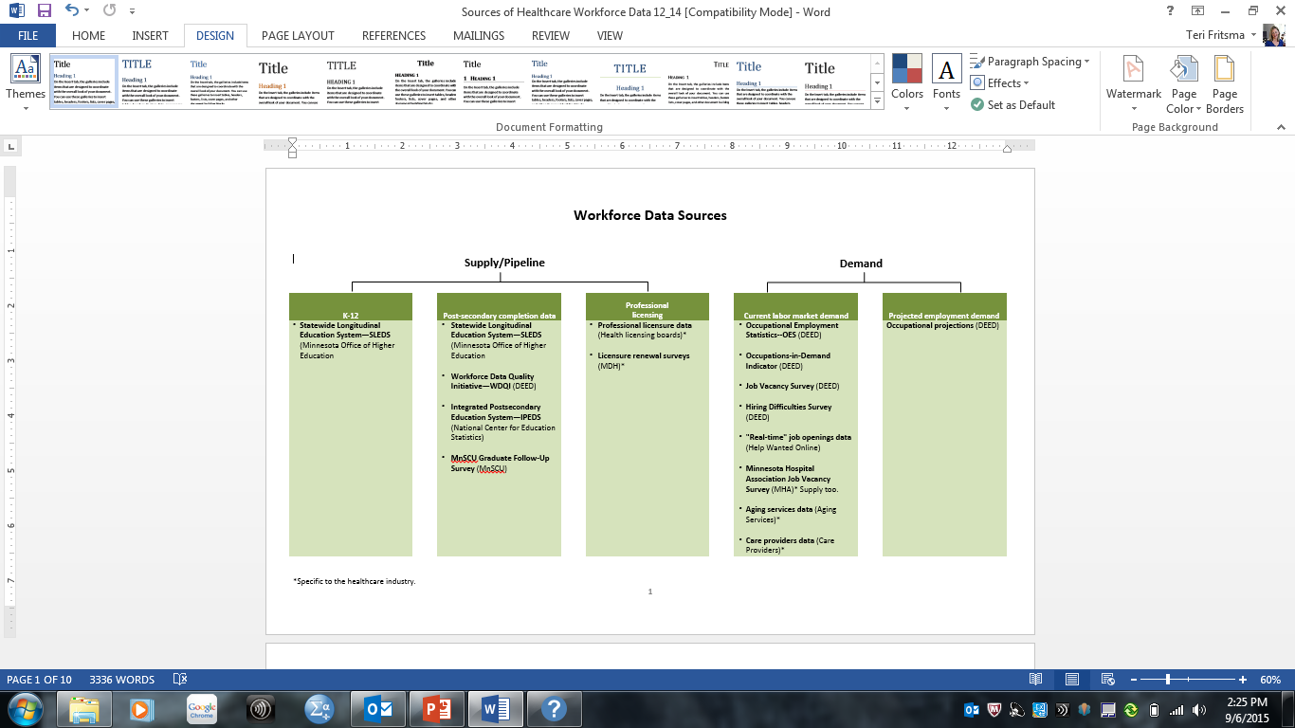
Overview of available healthcare workforce data
WHAT?
Where my office fits in

Slide 8
Overview of available healthcare workforce data
HOW?
Data are collected and analyzed here in Minnesota, but most data sets are part of national initiatives governed partly or fully by pre-established timelines, rules, and methodologies.

Slide 9

How can we pull it together to say something meaningful?

Slide 10
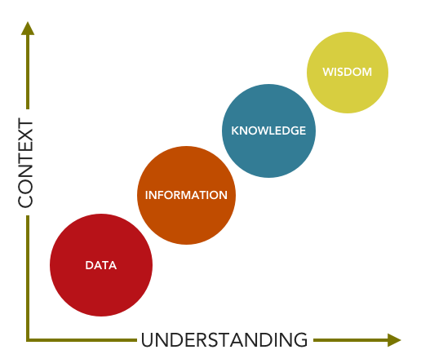
Notes:
To really be able to talk about the diversity of this provider group, we do need to understand more about the diversity of the region itself. In NW Minnesota, 8% of the population are people of color; compared to 14.7% statewide.
Also, we can compare the provider populations in other regions of the state. With the exception of the Twin Cities region which tend to be slightly more diverse, providers in the NW area are not less diverse than in other areas of the state.
This doesn’t mean there’s not room for improvement…

Slide 11
Today’s discussion
Overview of the healthcare workforce data available in Minnesota
Walk through a scenario of how these data can be applied to a policy question
Update on NGA data work

Slide 12
Healthcare workforce example: fitting the pieces together
Scenario:
It’s been suggested that there are not enough providers to meet the mental/behavioral health needs of residents in the northwestern part of Minnesota.
Furthermore, some say NW Minnesota providers are almost all Caucasian, perhaps ill-prepared to provide culturally competent care to those on Indian reservations.
Would expanding the U of MN Moorhead program to include a Master’s degree in social work help fill the gaps in NW MN?
Notes:
Quick overview of what I’ve pulled together…

Slide 13
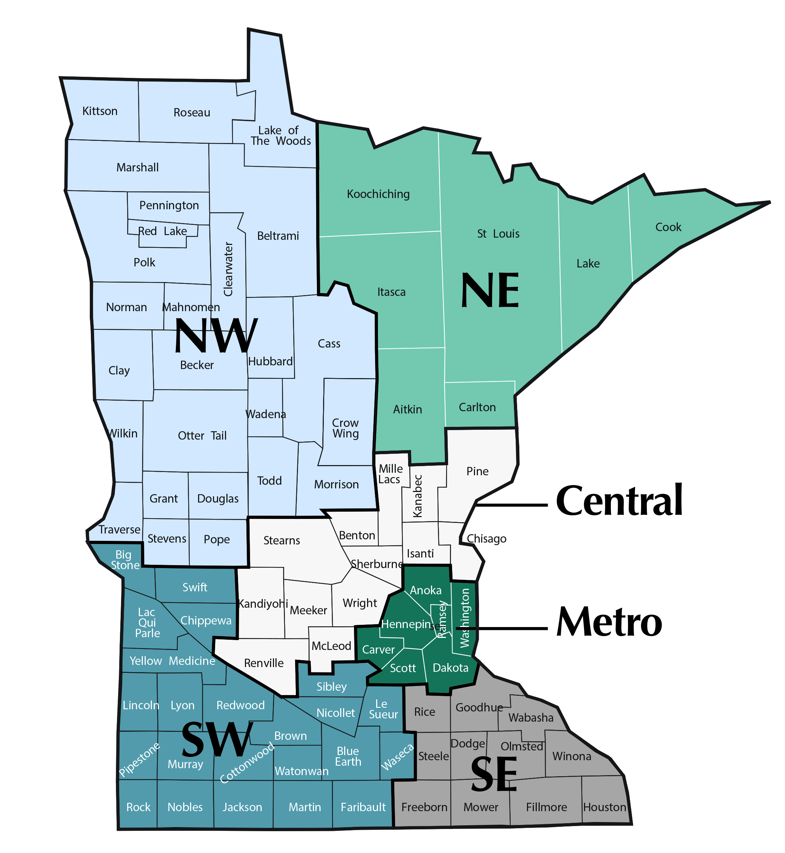
Minnesota planning regions
Population:
557,666 (10%)
326,373 (6%)
689,638 (13%)
2,950,885 (54%)
393,507 (7%)
499,769 (9%)
Population estimates are from the Minnesota State Demographic Center for 2013. Release date July 15, 2014.

Slide 14
Scenario—Part 1:
Are there “enough” mental health providers in NW Minnesota?
COUNTS
Number of Residents Per every Provider
Minnesota Region | Psychiatrists | Psychologists | Social Workers* | Marriage and Family Therapists | LPCs and LPCCs | Psychiatric Nurses
Northwest | 32,804 | 3,064 | 7,435 | 9,784 | 9,294 | 16,402
Mpls/St. Paul | 8,756 | 1,183 | 3,323 | 2,654 | 4,431 | 19,287
Statewide | 10,901 | 1,540 | 3,533 | 3,639 | 5,082 | 17,881
*LICSWs who provide mental/behavioral health services ONLY.
Source: Healthcare Licensing Boards and Minnesota Population data
Notes:
Physicians – pop to provider ratio in NW is 770 / 1,631 for primary care physicians.
Northwest is not all that different from other areas of the state in terms of MH providers.
Note: Number of providers…

Slide 15
Scenario—Part 1:
Are there “enough” mental health providers in NW Minnesota?
MARKET DEMAND
“Occupations In Demand” Indicator, 2014, Northwest Minnesota
Mental Health Counselors:
Substance Abuse and Behavioral Disorder Counselors:
Child, Family, and School Social Workers:
Mental Health and Substance Abuse Social Workers:
Healthcare Social Workers:
Clinical, Counseling, and School Psychologists:
Source: DEED, Occupations In Demand
Notes:
Note: No graduates of:
- Marriage and Family Therapy Programs
- Clinical Psychology
- Mental Health Counseling
- Educational Psychology
- Applied Psychology
- And of course, no psychiatry residencies.

Slide 16
Scenario—Part 2:
Are mental health providers in Northwest MN diverse enough?
RACE
Race of Mental Health Providers in Northwest Minnesota
Race | Psychiatrists | Psychologists | Social Workers | Marriage and Family Therapists | LPCs and LPCCs | Psychiatric Nurses
American Indian | 0% | No data available | 1% | 0% | No data available | 4%
Asian | 8%
 |  |  | 1% | 3% |  | 0.0%
Black | 0% |  | 0% | 0% |  | 0.0%
White | 75% |  | 93% | 95% |  | 91%
Other | 0% |  | 0% | 0% |  | 4%
Multi-racial | 0% |  | 2% | 0% |  | 4%
Source: MDH Workforce Survey, multiple years
Notes:
To really be able to talk about the diversity of this provider group, we do need to understand more about the diversity of the region itself. In NW Minnesota, 8% of the population are people of color; compared to 14.7% statewide.
Also, we can compare the provider populations in other regions of the state. With the exception of the Twin Cities region which tend to be slightly more diverse, providers in the NW area are not less diverse than in other areas of the state.
This doesn’t mean there’s not room for improvement…

Slide 17
Scenario—Part 3:
Would adding an MSW program at
U of MN-Moorhead help fill the gap?
PROGRAM GRADUATES
Mental Health Program Completers in Northwest Minnesota, 2012-2013
Program Title | Program Length/Award Level
 | Up to 1 Year | Over 1 & Under 4 Years | 4 Years | Graduate Level | TOTAL
General Psychology | 0 | 0 | 171 | 0 | 171
Social Work | 0 | 0 | 110 | 0 | 110
School Psychology | 0 | 0 | 0 | 26 | 26
Counseling Psychology | 0 | 0 | 0 | 7 | 7
Substance Abuse/Addiction Counseling | 0 | 4 | 0 | 0 | 4
Total, NW Minnesota | 0 | 4 | 281 | 33 | 318
Source: Integrated Postsecondary Education Data System (IPEDS)
Notes:
Note: No graduates of:
- Marriage and Family Therapy Programs
- Clinical Psychology
- Mental Health Counseling
- Educational Psychology
- Applied Psychology
- And of course, no psychiatry residencies.

Slide 18
Scenario—Part 3:
Would adding an MSW program at
U of MN-Moorhead help fill the gap?
In a survey conducted at the 2015 APRN Psychiatric Nursing conference, about half of health care providers said that they practice within 25 miles of where they completed their education.
Just over one-third of health care providers work within 25 miles of where they grew up.
Source: 2015 survey conducted at the APRN Psychiatric Nursing Conference
Notes:
To really be able to talk about the diversity of this provider group, we do need to understand more about the diversity of the region itself. In NW Minnesota, 8% of the population are people of color; compared to 14.7% statewide.
Also, we can compare the provider populations in other regions of the state. With the exception of the Twin Cities region which tend to be slightly more diverse, providers in the NW area are not less diverse than in other areas of the state.
This doesn’t mean there’s not room for improvement…

Slide 19
Scenario—Part 3:
Would adding an MSW program at
U of MN-Moorhead help fill the gap?
Region of Education | Region of Employment |  |  |  |  |  |  | Total
 |  | Central | Northeast | Northwest | Twin Cities | Southeast | Southwest
Central |  | 51 | 3 | 16 | 22 | 0 | 1 | 97
 |  | 52.6% | 3.1% | 16.5% | 22.7% | 0.0% | 1.0% | 100.0%
Northeast |  | 0 | 1 | 0 | 3 | 0 | 0 | 4
 |  | 0.0% | 25.0% | 0.0% | 75.0% | 0.0% | 0.0% | 100.0%
Northwest |  | 0 | 0 | 2 | 0 | 1 | 0 | 3
 |  | 0.0% | 0.0% | 66.7% | 0.0% | 33.3% | 0.0% | 100.0%
Twin Cities |  | 66 | 19 | 13 | 789 | 31 | 13 | 962
 |  | 6.9% | 2.0% | 1.4% | 82.0% | 3.2% | 1.4% | 100.0%
Southeast |  | 0 | 0 | 0 | 1 | 0 | 0 | 1
 |  | 0.0% | 0.0% | 0.0% | 100.0% | 0.0% | 0.0% | 100.0%
Southwest |  | 4 | 3 | 2 | 6 | 5 | 29 | 50
 |  | 8.0% | 6.0% | 4.0% | 12.0% | 10.0% | 58.0% | 100.0%
North Dakota |  | 3 | 0 | 14 | 6 | 0 | 1 | 28
 |  | 10.7% | 0.0% | 50.0% | 21.4% | 0.0% | 3.6% | 100.0%
Total |  | 146 | 50 | 57 | 1112 | 59 | 65 | 1578
 |  | 9.3% | 3.2% | 3.6% | 70.5% | 3.7% | 4.1% | 100.0%
Source: Minnesota Board of Marriage and Family Therapy
Notes:
To really be able to talk about the diversity of this provider group, we do need to understand more about the diversity of the region itself. In NW Minnesota, 8% of the population are people of color; compared to 14.7% statewide.
Also, we can compare the provider populations in other regions of the state. With the exception of the Twin Cities region which tend to be slightly more diverse, providers in the NW area are not less diverse than in other areas of the state.
This doesn’t mean there’s not room for improvement…

Slide 20
Healthcare workforce example
What have we learned?
Current provider counts: Low
Racial diversity: Fairly low
Market demand: Very high
Capacity to grow more: Questionable
Mobility: About half will stay in area where they trained
We’re between information and knowledge
Notes:
To really be able to talk about the diversity of this provider group, we do need to understand more about the diversity of the region itself. In NW Minnesota, 8% of the population are people of color; compared to 14.7% statewide.
Also, we can compare the provider populations in other regions of the state. With the exception of the Twin Cities region which tend to be slightly more diverse, providers in the NW area are not less diverse than in other areas of the state.
This doesn’t mean there’s not room for improvement…

Slide 21
Today’s discussion
Overview of the healthcare workforce data available in Minnesota
Walk through an example of how these data can be applied to a policy question
Update on NGA data work

Slide 22
NGA data work
Broad data-related goals:
Catalogue healthcare workforce datasets
Address gaps in healthcare workforce data
Better ways to disseminate/publicize data

Slide 23
NGA data work
Goal 1:
☑ Catalogue healthcare workforce datasets

Slide 24
NGA data work
Goal 2:
Address gaps in workforce data
Longitudinal dataset that tracks program completers through career transitions
Addressing gaps specific to mental health workforce data
Beginning to collect data on new and emerging models of care
Re-designing our MDH workforce surveys to anticipate and “get ahead” of policy questions.

Slide 25
NGA data work
Goal 3:
Better ways to disseminate data
How do (or would) YOU use workforce data?

Slide 26
Contact Information
Teri Fritsma
Senior Workforce Analyst
Minnesota Department of Health,
Office of Rural Health and Primary Care
Healthcare Workforce Analysis Team
Teri.Fritsma@state.mn.us
(651) 201-4004

