Slide 1

Spring/Summer 2015 RECAP
Notes:
Will cover:
Genesis of the state plan
Process for generating recommendations
The 24 recommendations in the state plan
In depth look at several recommendations that have the potential to impact rural Minnesota
Questions and discussion

Slide 2
1st Annual GIRLS ConnectZ DAY
A partnership with Girls Scouts of River Valley.
The ConnectZ Program serves girls of color and/or girls who qualify for free and reduced lunches.

Slide 3

GIRLS ConnectZ DAY – MAY 19TH, 2015
Three locations hosted 198 students:
Century College, White Bear Lake
  Total Attendees = 72
RCTC/WSU-R, Rochester
  Total Attendees = 96
South Central Community College, Mankato
  Total Attendees = 30

Slide 4
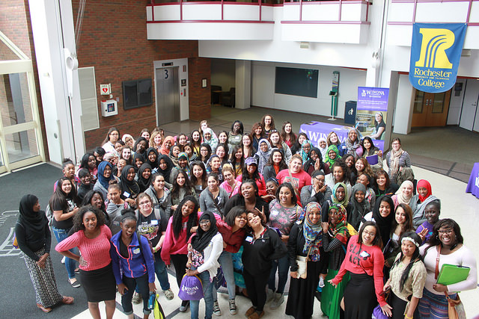
GIRLS ConnectZ DAY
Student Demographics
Students’ Diversity
Students’ Grades
Ethnicity | %
American Indian | 2%
Asian/Asian American | 19%
Black/African American | 43%
White/Caucasian | 4%
Hispanic/Latino/Spanish | 16%
Other | 3%
No Response | 13%
Grade | # of Students
9th Grade | 52
10th Grade | 57
11th Grade | 39
12th Grade | 24
No Response | 26
Total Students | 198

Slide 5
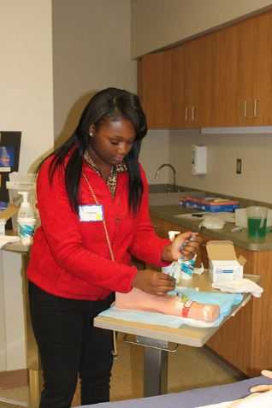
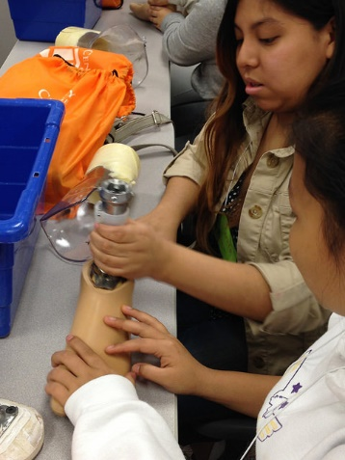
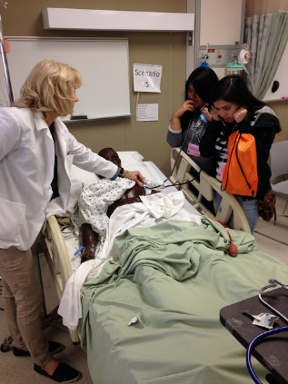
GIRLS ConnectZ DAY
High Points
80% reported being more knowledgeable about the different careers in healthcare after the experience.
71% of students reported being interested in pursuing career in healthcare after experience.
77% reported being more motivated to do well in school after experience.
71% reported they qualify for free/reduced lunches.
33% reported they are first generation college hopefuls.

Slide 6
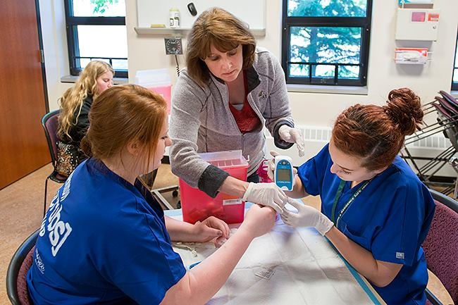
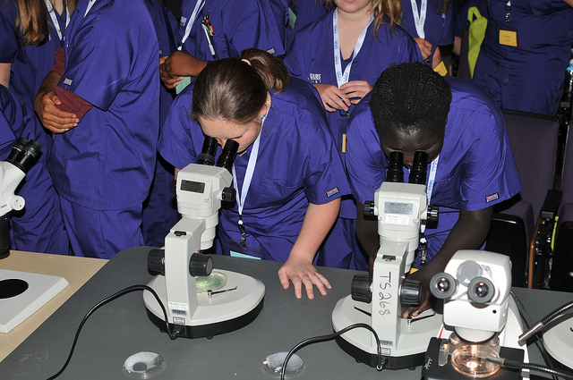
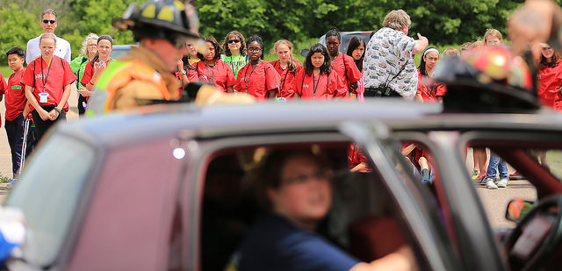
Summer Scrubs Camps

Slide 7
NINE TOTAL CAMPS
3 MIDDLE SCHOOL LOCATIONS:
Rochester (61 students)
Dakota County (35 students)
Winona (29 students)
Total Actual Attendees = 125
No shows = 16 (3 full pay and 13 scholarships)
6 HIGH SCHOOL LOCATIONS:
Fergus Falls (31 students)
Mankato (57 students)
Bemidji (23 students)
Winona (100 students)
Minneapolis/Urban (76 students)
St. Paul (57 students)
Total Actual Attendees = 344
No shows = 28 (all scholarships)
Total Camp Capacity = 520
Total Camp Actual Attendees = 469 (d/n count “no shows”)
90% of Camp Capacity
Denotes new camps for summer 2015.
Notes:
Not a new issue, but with the passage of the Affordable Care Act and mental health parity and not enough progress being made, NAMI Minnesota and other mental health stakeholders, the Minnesota legislature approved funds to develop a state mental health work plan

Slide 8
SCHOLARSHIPS AWARDED
MIDDLE SCHOOL
Rochester = 12
Dakota County = 13*
Winona = 16
No Shows = 13
Totals = 54 (41 actual)
HIGH SCHOOL
Fergus Falls = 26
Mankato = 21
Bemidji = 9
Winona = 44
Minneapolis = 48*
St. Paul = 42
No Shows = 28
Totals = 218 (190 actual)
TOP 15 CAMP FUNDERS
Regenerative Medicine MN $30,000
Otto Bremer $15,000
Boston Scientific $10,000
Ecumen $7,800
Fairview $7,200
Office of Higher Education $4,965
WSU Foundation $4,500
Allina $4,000
Rasmussen College $4,000
Regions $4,000
Step-Up Achieve $2,400
Mayo Foundation $2,375
Care Providers $2,000
Cedar Riverside Group $1,720
Olson Family Aloha Fund $1,600
Notes:
This is the legislation.
It was a large enough charge that we did not include workforce issues relevant to persons with autism or substance use disorders.
The Steering Committee recognized that there are significant workforce needs within these areas and that there are overlaps and co-occurring conditions.
It also recognized that adding the workforce issues from those communities would require the involvement of many additional individuals and would greatly broaden the scope of an already large task. As it was, we just completed the plan mid-December of 2014.
It is hoped that those communities can use this report to inform their respective workforce development plans.

Slide 9
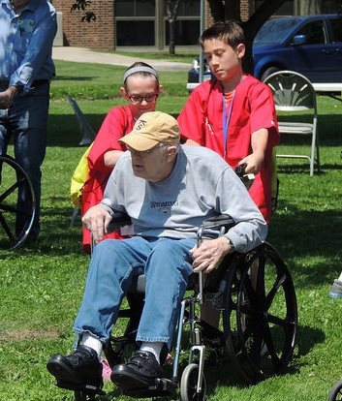
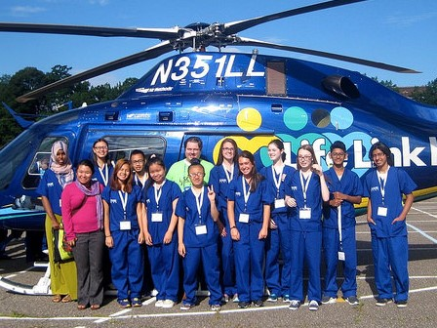
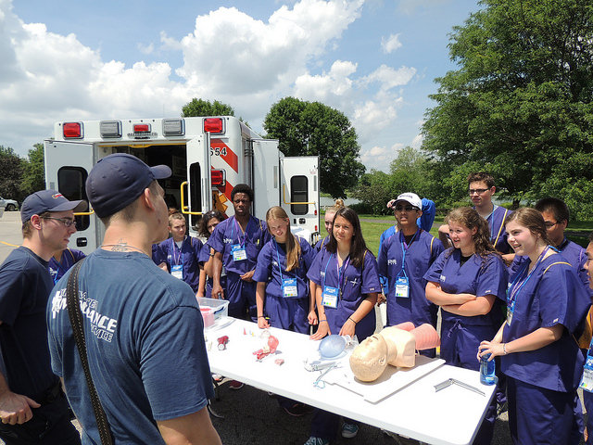
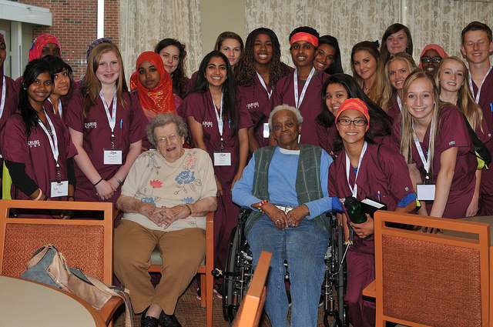
Employer Site Visits…
Carondelet Village
Catholic Elder Care
Episcopal Homes
Fergus Falls Regional Treatment Center
Gillette Children’s Specialty HealthCare
HealthEast Medical Transportation Center
Olmsted Medical Center
Mankato Clinic
Mayo Clinic Health Systems
Samaritan Bethany
Sanford Health
St. Anne’s of Winona
Sauer Homes
U of M Children’s Hospital
Winona Health
Notes:
A steering committee of 37 people representing the groups outlined in the legislation was formed.
The committee met monthly to determine information needed to hold a summit and write a state plan.

Slide 10
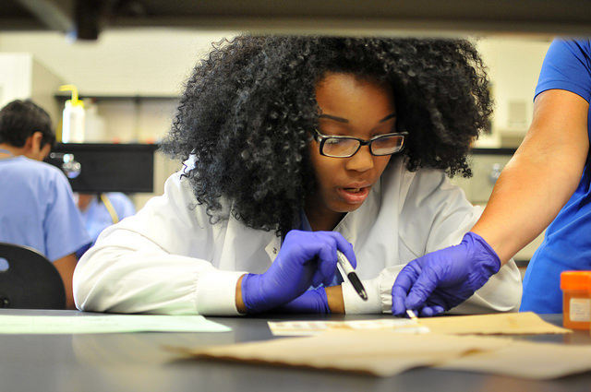
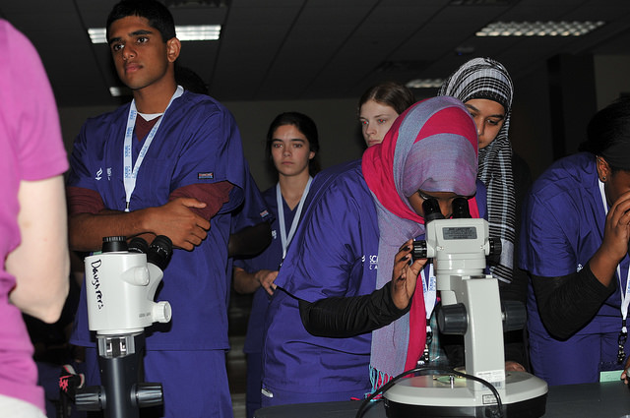

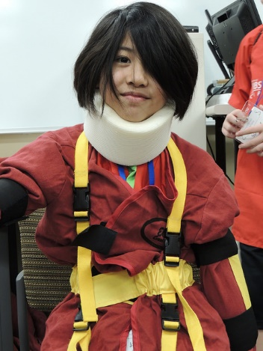
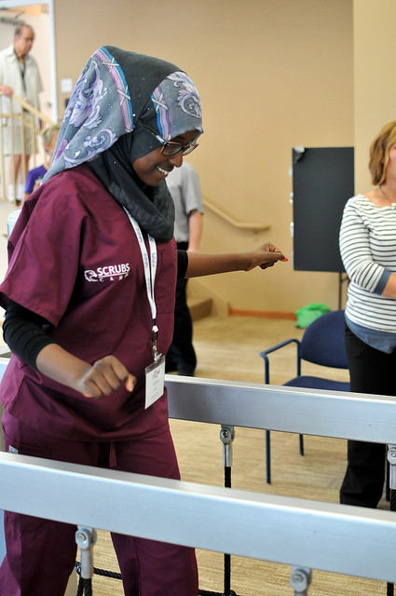
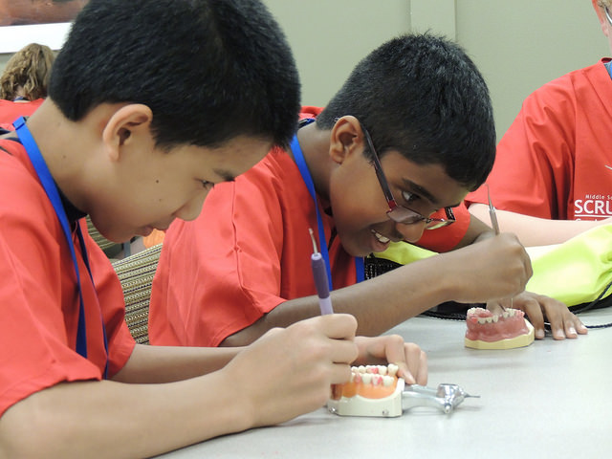
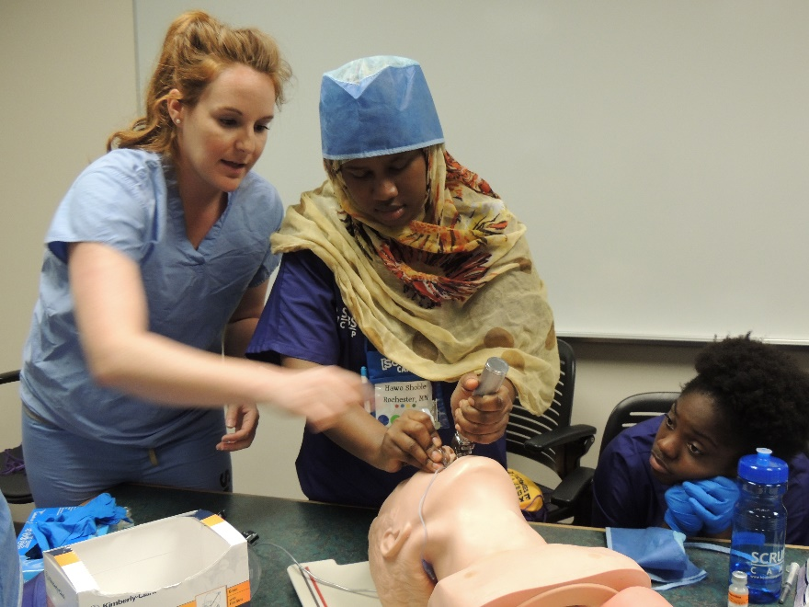
Notes:
1. Data report contracted to ISEEK to examine mental health professions as defined by The Health Resources and Services Administration (HRSA) as “core” (there is limited data on “non-professional” mental health workers.
Psychiatrists
Psychologists, Clinical, Counseling, & School Psychologists
Social Workers
Marriage & Family Therapists
Mental Health Counselors
Advanced Practice Psychiatric Nurse Practitioners
1A. Data Challenges to determining shortages due to the way professions are aggregated, for example standard occupational classifications will lump licensed and unlicensed counselors together. Part of it is due to the unavailability of data, for example employment surveys conducted by the Department of Employment and Economic Development do not include the self employed or those in private practice. Reminder that benchmarking was one of its major purpose.
Forums held in 20 venues around state.
Online survey that more than 500 people responded to
Summit at end of May, by invitation to ensure diversity, for 150 stakeholders
Analysis of 1999, 2004 and 2009 MN efforts
Examination of other states’ plans for best practices

Slide 11
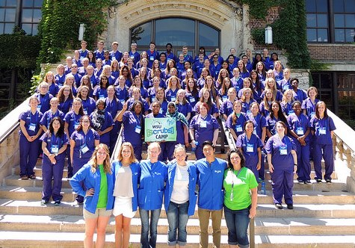
WSU High School Camp

Slide 12
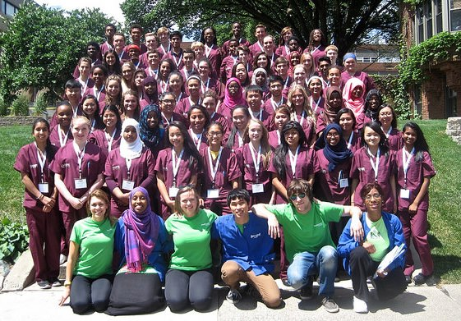
Urban High School Camp

Slide 13
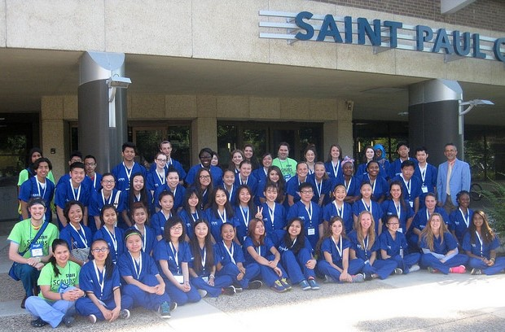
Saint Paul College High School Camp

Slide 14
LOOKING AHEAD TO SUMMER 2016

Slide 15
NEW CAMPS….
Saint Cloud
  Middle School Camp at SCTC
  High School Camp at SCSU
Moorhead
  High School Camp at MN State University-Moorhead
Minneapolis – Pending…
  Middle School Camp – City of Mpls Employment and Training
Duluth/Fond du lac Area – Pending…
  Middle School Camp and/or High School Camp
    Fond du lac Tribal and Community College
    Lake Superior College

Slide 16
Creating a Year Long Experience
Growing our healthcare workforce with the Health Care Core Curriculum in the high schools.
HCCC as a foundational course for health science programs in MN:
Increasing partnerships between colleges and high schools
High school students could earn college credit
Approved to use in the Nursing Assistant Pathway by MDH
NOCTI Assessment Test
Five HCCC grants awarded spring/summer of 2015
      Hibbing Community College (Hibbing and Chisholm HS)
      Inver Hills Community College (Burnsville HS)
      Pine Tech (North Branch HS)
      Rochester Community and Technical College (Triton HS – Dodge Center)
      South East Tech – Red Wing Campus (Zumbrota-Mazeppa HS)

Slide 17
QUESTIONS?
Misun Bormann
Statewide Director of K-16 Initiatives
mbormann@winona.edu
507-285-7133
Sue Field
Statewide Director of HEIP
sfield@winona.edu
651-707-5563

Slide 18
2015 Camp Videos
WSU High School Camp
Urban High School Camp
Saint Paul College High School Camp

