Slide 1
Labor Market Analysis of Minnesota’s Medical and Clinical Laboratories
Anthony Schaffhauser, HealthForce Minnesota

Slide 2
Industry Growth Trend
Source: DEED Quarterly Census of Employment & Wages
Notes:
Total jobs grew 8% from 2000 to 2016.
Medical and Diagnostic Labs Jobs grew 108%!
Does this mean that there is a dire shortage of workers in Med and Diag Labs?
Some industries can grow rapidly without generating shortages of workers. Supply and Demand in the labor market. The key dynamic is labr market conditions by OCCUPATION.

Slide 3
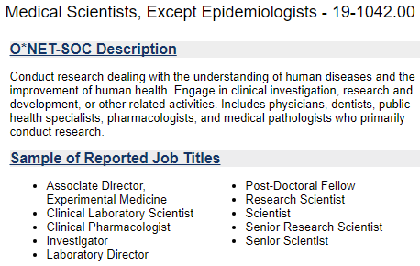

Which Occupations?

Slide 4
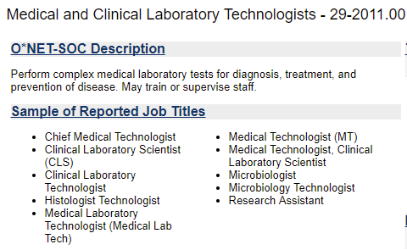

Which Occupations 2

Slide 5
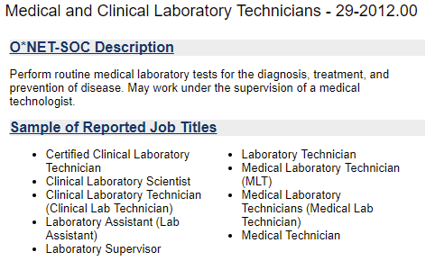

Which Occupations 3

Slide 6
This field is a big deal in MN. (MN DEED Occupational Employment Statistics )
Source: DEED Occupational Employment Statistics, Qtr. 1 2017 (https://mn.gov/deed/data/data-tools/oes/). A semi-annual survey designed to produce employment and wage estimates for about 800 occupation classifications.
Notes:
Note that Also, Med Clinical Lab Technologist pays more in MN! Interestingly, Medical Scientists are paid less in MN than the U.S., while the other occupations pay more in MN. I believe this is due to more public sector Med Scientist jobs in MN than in U.S. 54% of Medical Scientist Employment in MN is in Health Care and Social Assistance and State Colleges., with only 18% in the Professional, Scientific, and Technical Services industry. Nationally, the majority is in Professional, Scientific, and Technical Services. Healthcare doesn’t pay as well as “big pharma.”
These jobs are still a big deal in MN. Note that the concentration of these jobs in MN and the Twin Cities is slightly higher than in the US. I suspect Medical Scientists is higher in Southeast, MN , but because most employment is with one employer, Mayo Clinic, the data are suppressed to meet data privacy law.
Note that there are ~1.8 times as many more technologists than scientists, and more than technicians as well.

Slide 7
Job Postings (Real Time Talent )
Source: TalentNeuron Recruit aggregate online job postings. www. wantedanalytics.com accessed October 11, 2017. Counts of job postings in 2014 through 2017 by employers. (Excludes staffing agencies and positions posted anonymously on sites including Craigslist and Thumbtack.)
Notes:
Postings a little “bouncy” year to year, but overall growth. However, there is a consolidation into the Twin Cities of postings. Does is this corroborated with DEED data? Or is this just an artifact of online job postings proliferation in the Twin Cities?

Slide 8
Medical Scientists, Job Vacancy Survey (MN DEED)
Source: Biannual survey of employers to estimate hiring demand and job vacancy characteristics by industry and occupation. Information is gathered through a stratified sample of about 10,000 firms in 13 regions of Minnesota. Excludes private households, personnel service industry establishments and businesses with no employees.
Notes:
Yes, it’s true! DEED Job Vacancy Survey data corroborate the consolidation of job openings into the Twin Cities metro area. This also provides a case-in-point for the benefits of using multiple independent sources of data in figuring out labor market conditions. Every source of data has potential for error; they can be misleading. But, the chances of multiple sources all being wrong is very low.
In research speak, the probability of two independent “events” both happening, i.e., data from two sources both erroneous, is the product of the probability of each one being wrong. So for example, if there is a 15% chance that the wanted analytics data are wrong, and a 10% chance the JVS data are wrong, then the probability that both are wrong is only 1.5%. Use multiple independent sources!
Does anyone here have insights into this trend of Medical Scientist job consolidation into the Twin Cities?

Slide 9
Notes:
There is a spike in medical scientist hiring in the Twin Cities just recently. You can see the lull around the Great Recession. It is not recession proof. And it has sprung back and exceeded pre-recession for scientists.
Moving on to Medical and Clinical Technologists and Technicians, I will just highlight some of the major findings. HealthForce MN in partnership with DEED Regional Analysis Unit (pretty much everything we do is “in partnership”), will produce a report with all of the analysis and post it online and send the link to the email list for this event.

Slide 10
Job Postings (Real Time Talent )
Source: TalentNeuron Recruit aggregate online job postings. www. wantedanalytics.com accessed October 11, 2017. Counts of job postings in 2014 through 2017 by employers. (Excludes staffing agencies and positions posted anonymously on sites including Craigslist and Thumbtack.)
Notes:
Much stronger growth in postings than Medical scientists, and strong growth in the Central and Southeast regions.

Slide 11
Job Postings (Real Time Talent )
Source: TalentNeuron Recruit aggregate online job postings. www. wantedanalytics.com accessed October 11, 2017. Counts of job postings in 2014 through 2017 by employers. (Excludes staffing agencies and positions posted anonymously on sites including Craigslist and Thumbtack.)
Notes:
Strongest growth in postings, and strong growth in the Northern MN regions. Apparently using more technicians and fewer technologists in Northern MN.

Slide 12
Notes:
Even with strong growth, Replacement openings are the big deal, even more so than net job growth. (Succession Planning, un yea!) DEED and US BLS has realized that they have been underestimating replacement openings and with next LT Projections will be adjusting upward.
Uncertainties going forward: healthcare policy and an apparent disdain for science in some political circles.

