Slide 1
Unit 3: Plan to be Successful
Time Management Skills
Written by Kathleen McCullough-Zander, MA, RN, CTN

Slide 2
Studying nursing
Suggested: need 3 hours of study for every 1 hour of class
English learners may need to multiply this three times!
You will need much more time to study nursing than other college classes you have had

Slide 3
You need to examine
Hours of work per week
Family responsibilities
How much sleep you need
Commuting time to school & work
How much time do you have for study?

Slide 4
Developing an organization plan
A key to success
Look at the syllabus – understand the total amount of work needed for each class
Month-at-a-glance calendars
Weekly calendar – prioritize!

Slide 5
Assignment 1 due
Assignment 2 due
Care plan due

Slide 6
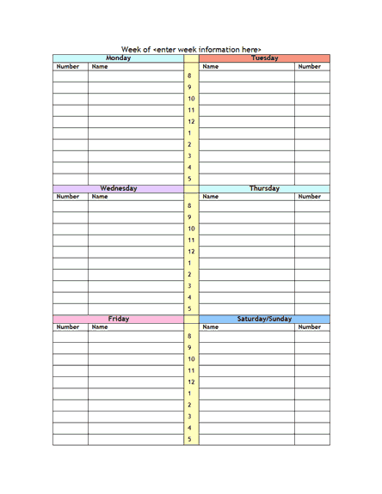
Work on paper
Meet with study group
Study chapters 2-8

Slide 7
Suggested tips
Have blocks of time planned for study
Plan for periods of un-interrupted study
Do the most difficult things first
Need to sleep, eat well (↓ sugar), & exercise
Start early on big projects

