Slide 1
Unit 8: How to improve English language skills
Written by Kathleen McCullough-Zander, MA, RN, CTN

Slide 2
Language learning
Nursing requires high levels of English proficiency in:
speaking
reading
listening
writing
Nurses use different types of English:
conversational
academic
medical

Slide 3
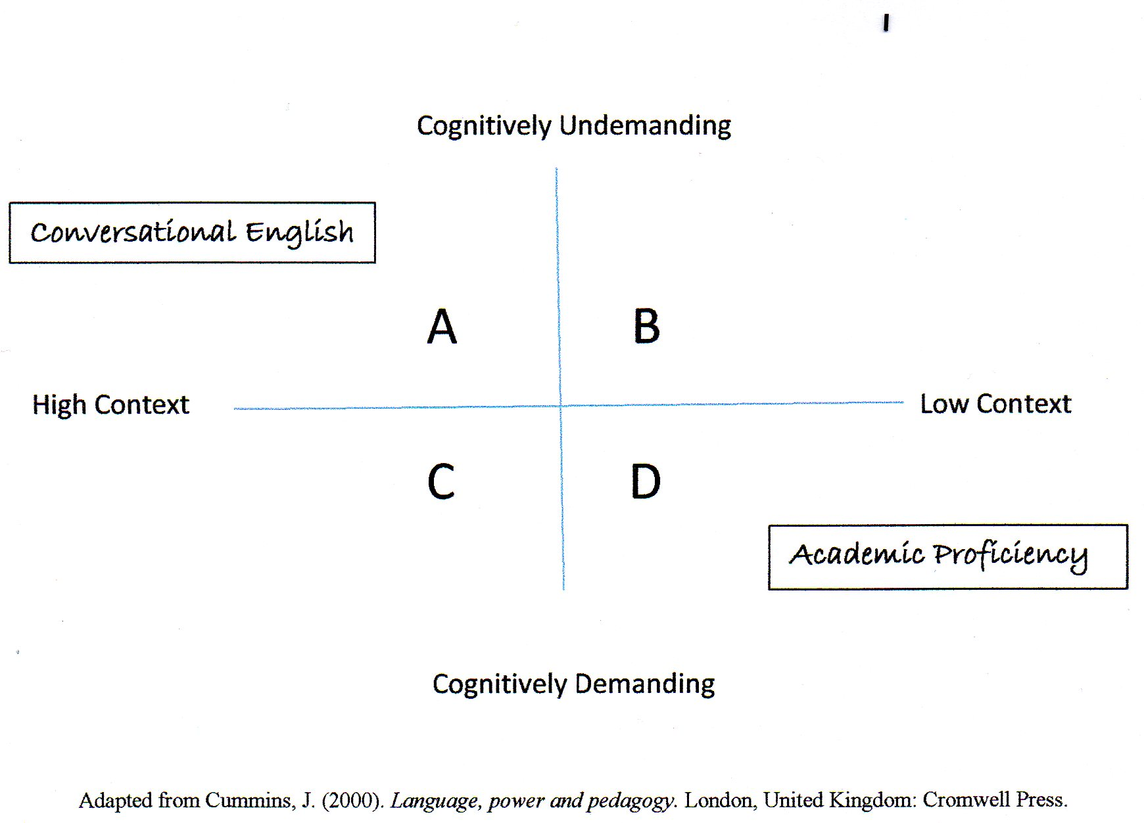
Progress through A-D
2-3 years for A
5-10 years for D
Nurses need to be at the level of academic proficiency to be successful.

Slide 4
English language acculturation Quiz

Slide 5
Grading the ELAS quiz
Average all the answers for your score
Low English proficiency: 0-4
Medium English proficiency: 4-4.75
High English proficiency: 4.76-5

Slide 6
Strategies to improve English skills
Explain the nursing concepts to someone in your own primary language
Draw a concept map of the content you need to learn
Tape record any lectures or discussion, then transcribe into your language
Make a vocabulary notebook or cards
Have mixed study groups including native English speakers

Slide 7
Strategies to improve English skills Continued…
Use study guides and practice test questions
Continue taking English writing classes
Use the Learning Center with written assignments
If you have a strong accent – classes in accent reduction

