Slide 1
Designing Simulation
Molly Kellgren, MSN, RN, CNE, CHSE National League for Nursing
Rose Raleigh, MS, RN Century College
Carol Reid, PhD, RN, CNE Metropolitan State University

Slide 2
Objectives
Using a needs assessment identify gaps in clinical learning opportunities within the curriculum.
Create measurable objectives based on the needs assessment.
Discuss methods for using simulation to meet learning objectives.
4. Develop a simulation that facilitates achievement of the learning objectives

Slide 3
INACSL Standard: Simulation Design
Perform a needs assessment
Construct objectives
Structure the format
Design a scenario
Creating fidelity
http://www.nursingsimulation.org/article/S1876-1399(16)30126-8/fulltext

Slide 4

Part 1
Needs Assessment
Objectives
Formatting the simulation

Slide 5

Needs Assessment
Criteria:
Provides foundational evidence of the need
Guides In developing objectives
Identify gaps
Notes:
Underlying causes of a concern (root cause or gap analysis)
Organizational analysis (SWOT)
Survey stakeholders, participants, educators
Outcome dataSelf assessment based on
Peer review
Observation
Significant event
Identify learning needs
Results in improved patient care
Informs practices, content, methodology

Slide 6

Needs assessment includes analysis of
Underlying causes of a concern
Organizational analysis
Survey of stakeholders
Outcome data
Standards

Slide 7
Needs assessment results
Assist designers to create experiences which
Enhance curriculum by informing practices, content, methodology
Standardize clinical experiences
Address competencies
Promotes readiness for clinical practice
Leads to improved patient care (quality and safety)

Slide 8
Needs Assessment
Reflect on a course you are teaching, your curriculum, a specific topic or content area
Where is the gap?
Discuss with others at your table
Each person record an idea on a card at your table
Notes:
Clinical opportunities lacking
Areas on ATI, HESI, etc.. where students score low.
Can be part of theory. Can take place in the classroom.

Slide 9
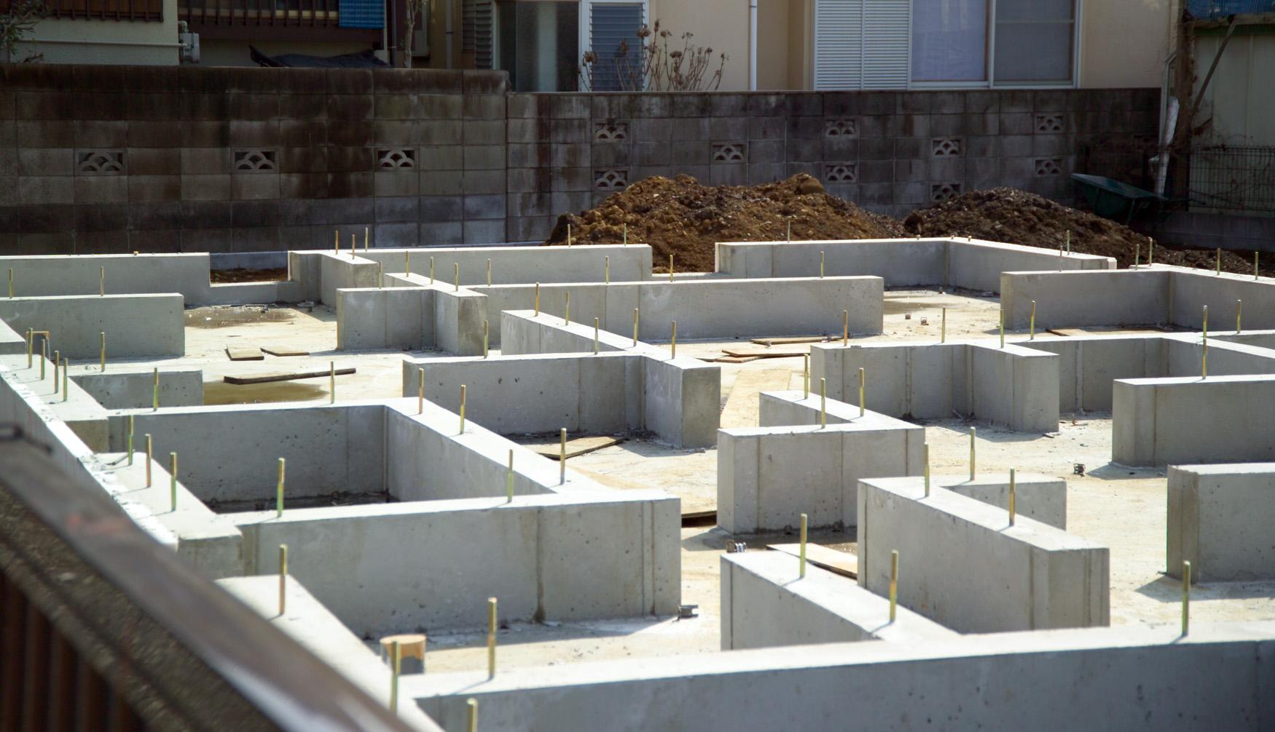
Constructing Objectives
Refer to INACSL Standards of Best Practice: Simulation Outcomes and Objectives
Criteria:
Determine expected outcomes for simulation-based activities and/or programs.
Construct S.M.A.R.T. objectives based on expected outcomes

Slide 10
Objectives
Broad (organizational goals) and specific (participant performance measures) objectives.
Objectives provide the blueprint for the simulation.
Determine which objectives will and or will not be available.
Drive the design, development and approach.
Facilitator guides the achievement of objectives.

Slide 11
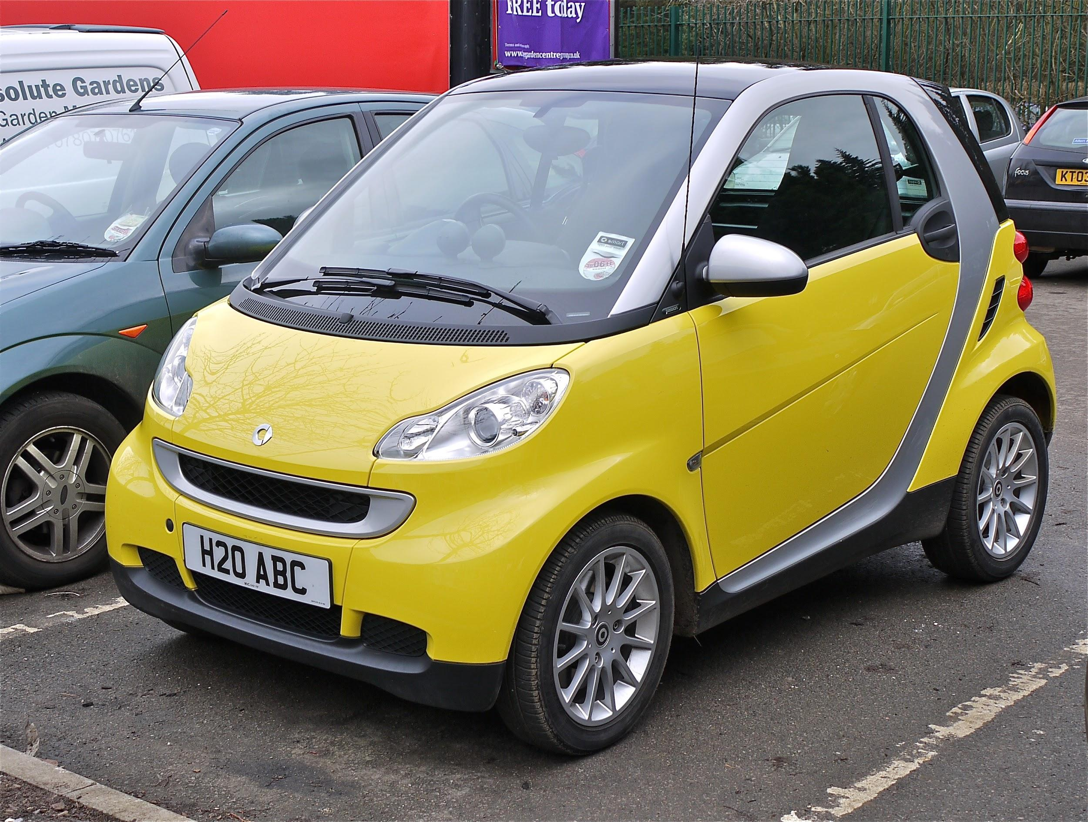
S.M.A.R.T. Objectives
Specific
Measurable
Achievable
Realistic
Time phased

Slide 12
S.M.A.R.T. Objectives-practice
Specific, Measurable, Achievable, Realistic, Time phased
Scenario: Mock code
Objective: The participants will perform a mock code.
Change the objective to meet the S.M.A.R.T. criteria

Slide 13
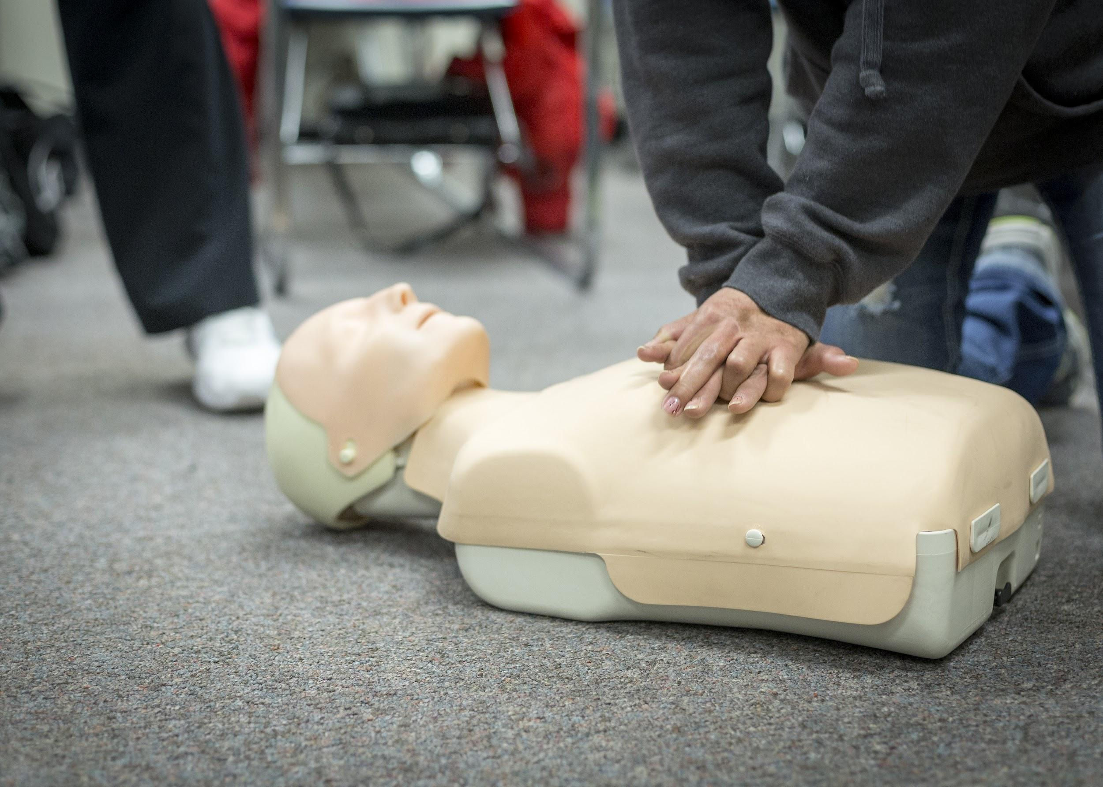
S.M.A.R.T. Objectives-practice
Objective: The participants will perform a mock code.
Better objective: The participants will implement resuscitation measures within 2 minutes of noticing a fatal dysrhythmia.

Slide 14
S.M.A.R.T. Objectives-practice
Specific, Measurable, Achievable, Realistic, Time phased
Scenario: Caring for a 12 year old with a brain tumor who tells the nurse they want to stop chemo.
Objective: The participant will communicate with the patient.
Change the objective to meet the S.M.A.R.T. criteria
Notes:
Start thinking of objectives you would want to meet.

Slide 15

S.M.A.R.T. Objectives-practice
Objective: The participant will communicate with the patient.
Better: The participant will effectively utilize at least 2 therapeutic communication techniques.
Simulation time: 10 minutes.
Notes:
Start thinking of objectives you would want to meet.

Slide 16
Format of the simulation
Based on
Needs Assessment
Resources
Objectives
Participants
Theory
Modality
Provides
Structure
Process
Expected outcomes

Slide 17

Format of the simulation
Purpose - provide formative and/or summative encounter
Theoretical/Conceptual framework - based on identified purpose & targeted participants
Modality - platform
Notes:
Simulated clinical immersion, computer-based, virtual reality, procedural/skill based, or hybrid
Using standardized patient, manikin, haptic device, avatar, partial task trainer, or combination

Slide 18
Structure of the simulation
Initial circumstances/patient situation
What is the story - why engage?
Structured participant activities that engages participants
What should they do? Actions, interventions, reactions
Expected outcomes are met
How do we know it’s done?

Slide 19

Lunch
Notes:
Gather notes from participants and place themes on tables

Slide 20
Part 2
Designing and Adapting a Scenario
Creating Fidelity

Slide 21

Designing a Scenario
Don’t start from scratch!
National League for Nursing (ACE.S, ACE.V, ACE.Z) - VETTED!
MnSHEP
Montgomery College
University of South Dakota

Slide 22

How to Adjust
Let’s look at Julia and Lucy:
Julia Morales, age 65, and Lucy Grey, age 73, are partners who have been together for more than 25 years. They are retired and have spent the past several years traveling together. Julia has lung cancer, which has been treated with chemotherapy and radiation, and now she wishes to stop treatment. Lucy is supportive and feels she will be able to care for Julia in their home. Lucy's past medical history includes a knee replacement. Their support system includes Julia's son, Neil, and Lucy's niece, Nora.
Notes:
Two foci: 1) Using already developed cases as is. What content/concept areas could you meet with the information within this description?
2) What concept/content areas do you have that haven’t been addressed? How could we address this case to meet those needs?
30 minutes. Within your groups are there ways to tweak this case to meet their objectives.

Slide 23
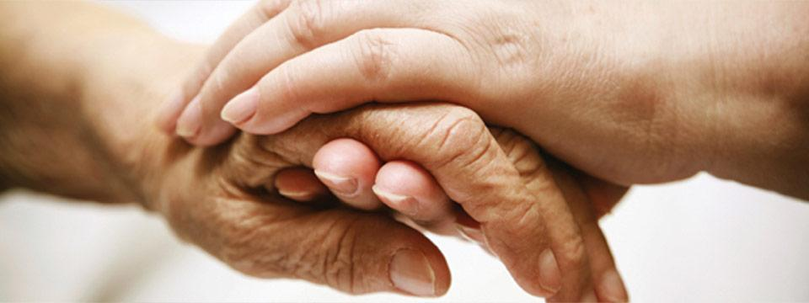
Some Possibilities
Julia Morales, age 65, and Lucy Grey, age 73, are partners who have been together for more than 25 years. They are retired and have spent the past several years traveling together. Julia has lung cancer, which has been treated with chemotherapy and radiation, and now she wishes to stop treatment. Lucy is supportive and feels she will be able to care for Julia in their home. Lucy's past medical history includes a knee replacement. Their support system includes Julia's son, Neil, and Lucy's niece, Nora.
Notes:
Anyone see anything else?

Slide 24
Actual Objectives, part 1
1. Provide care for terminally ill older adult and her family in the home setting.
2. Perform physical and functional assessments of older adult.
3. Identify purpose of hospice care and services provided.
4. Explain advance directives and durable power of attorney.
5. Relate the importance of providing individualized care unique to each individual and family.
Notes:
At your tables, what would you change to meet your specific objectives?
If time allows, begin to outline the progression.
Shoot for finishing at 2:00.

Slide 25
Keeping it Real: Creating Fidelity
It’s not about the manikin
Make the scenario as real as possible
Objectives drive the fidelity
High fidelity simulation without a high fidelity manikin

Slide 26
• “During the design of scenarios, the simulation team should try to anticipate where participants are more likely to do something unexpected, such as when they have more than one option for action.”
• “This means that the simulation team works mentally through the scenario, trying to identify where participants could do something unexpected, how an unexpected action would be recognized, and how the simulation team could react in such a case.”
Dieckmann, P., Lippert, A., Glavin, R., & Rall, M. (2010)

Slide 27
Contact Information
Carol Reid, PhD, RN, CNE
carol.reid@metrostate.edu
Molly Kellgren, MSN, RN, CNE, CHSE
mkellgren@nln.org
Rose Raleigh, MS, RN
rose.raleigh@century.edu

Slide 28
References
Dieckmann, P., Lippert, A., Glavin, R., & Rall, M. (2010). When things do not go as expected: scenario life savers. Simulation in Healthcare, 5(4), 219-225.
HealthPartners Clinical Simulation. (2016). Scenario Template.
International Nursing Association for Clinical Simulation and Learning. (2016). Standards of best practice: Simulation. SM Clinical Simulation in Nursing 12, S1-S50. Retrieved from http://www.nursingsimulation.org/issue/S1876-1399(16)X0014-X
Lioce, L., Meakim, C.H., Fey, M.K., Chmil, J.V., Mariani, B., Alinier, G. (2015). Standards of best practice: Simulation standard IX: Simulation design. Clinical Simulation in Nursing, 11, 309-315. doi: 10.1016/j.ecns.2015.03.005

